Slide 1
MAGNETIC FIELDS
Session 9
SCIE6063
COMPUTATIONAL PHYSICS
June 2024

Slide 2
These slides have been adapted from
Halliday D.; Resnick R. and Walker J. (2018). Fundamentals Of Physics ,Extended,
11th , John Wiley & SONS Inc, New York, ISBN: 9781119306856
Chapter 28+29

Slide 3
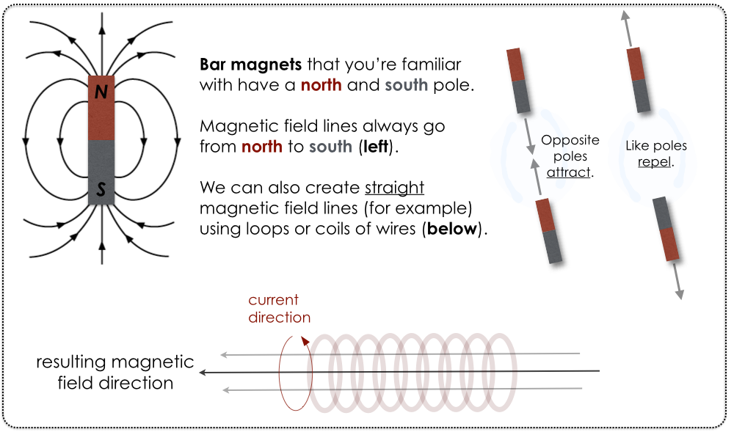
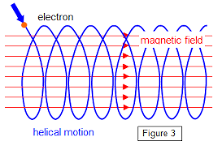
What Produces Magnetic Field?
One way that magnetic fields are produced is to use moving electrically charged particles, such as a current in a wire, to make an electromagnet. The current produces a magnetic field that is utilizable.
The other way to produce a magnetic field is by means of elementary particles such as electrons, because these particles have an intrinsic magnetic field around them.
Thomas G. McCarthy

Slide 4
What Produces Magnetic Field?
The magnetic fields of the electrons in certain materials add together to give a net magnetic field around the material. Such addition is the reason why a permanent magnet, has a permanent magnetic field.
In other materials, the magnetic fields of the electrons cancel out, giving no net magnetic field surrounding the material.
Thomas G. McCarthy

Slide 5
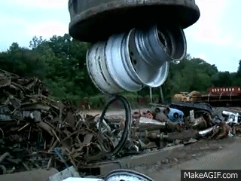
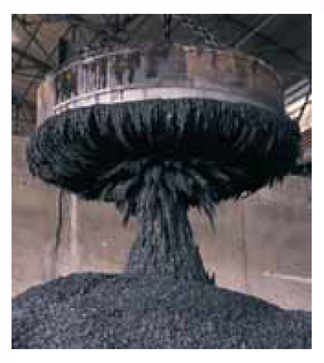
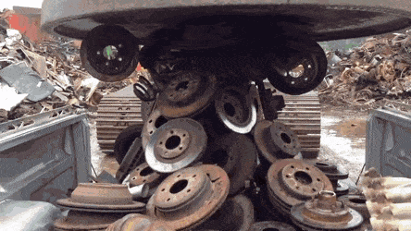

Slide 6


1. The Definition of B
We can define a magnetic field, B, by firing a charged particle through the point at which is to be defined, using various directions and speeds for the particle and determining the force that acts on the particle at that point. B is then defined to be a vector quantity that is directed along the zero-force axis.
The magnetic force on the charged particle, F_{B}, is defined to be:
Here q is the charge of the particle, V is its velocity, and B the magnetic field in the region. The magnitude of this force is then:
Here φ is the angle between vectors v and B.

Slide 7



2. Magnetic Force on a Particle
The force acting on a charged particle moving with velocity through a magnetic field is :
The force is always perpendicular to
If q is positive, then the direction of is in the
direction of .
If q is negative, then the direction of is opposite that
of

Slide 8




Magnetic Force on a Particle (cont.)
The SI unit for B that follows is Newton per coulomb-meter per second. For convenience, this is called the Tesla (T):
An earlier (non-SI) unit for B is the gauss (G), and

Slide 9
Magnetic Force on a Particle (cont.)
Magnetic Field Lines:
The direction of the tangent to a magnetic field line
at any point gives the direction of B at that point.
The spacing of the lines represents the magnitude
of B —the magnetic field is stronger where the lines
are closer together, and conversely.

Slide 10
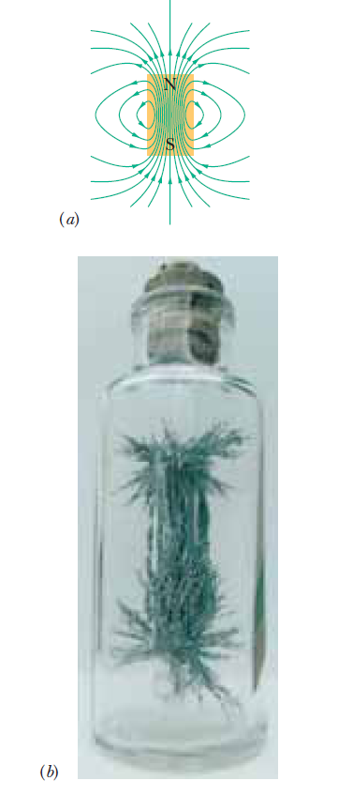
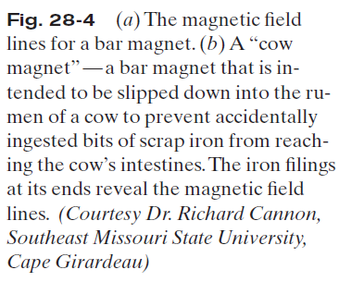
The direction of the tangent to a magnetic field line at any point gives the direction of B at that point.
The spacing of the lines represents the magnitude of B —the magnetic field is stronger where the lines are closer together, and conversely.

Slide 11
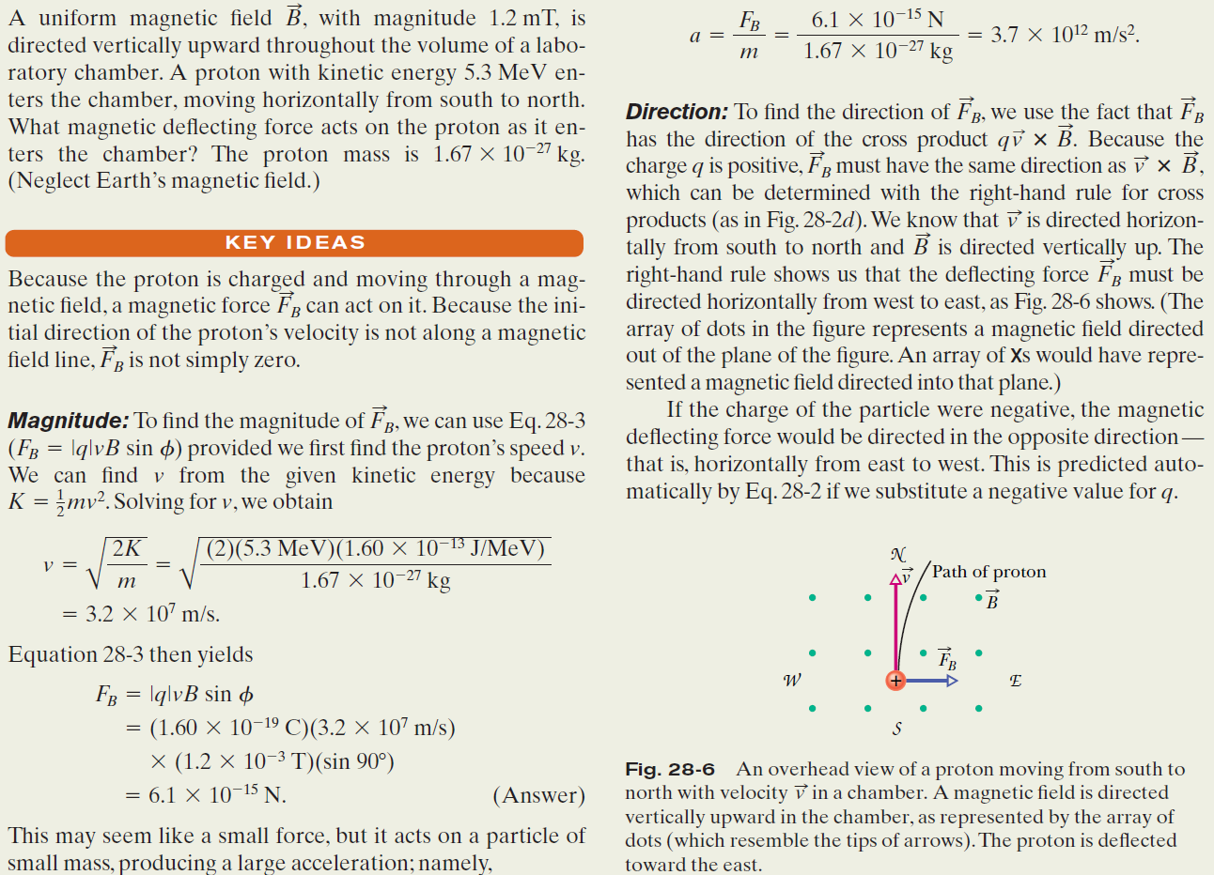
Magnetic Force on a Particle (cont.)
Example, Magnetic Force on a Moving Charged Particle :

Slide 12
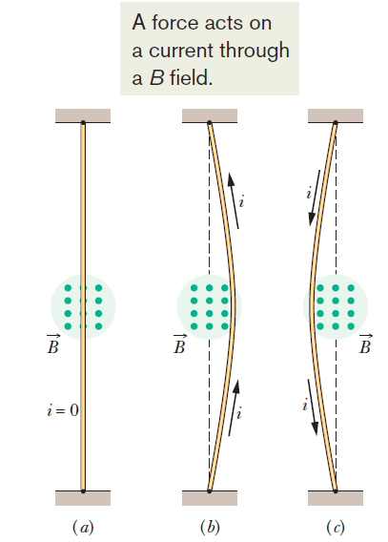
4: Magnetic Force on a Current-Carrying Wire
Fig.2. A flexible wire passes between the pole faces of a magnet (only the farther pole face is shown).
Without current in the wire, the wire is straight.
(b) With upward current, the wire
is deflected rightward.
(c) With downward current, the
deflection is leftward.
The connections for getting the current into the wire at one end and out of it at the other end are not shown

Slide 13



Magnetic Force on a Current-Carrying Wire (cont.)
Consider a length L of the wire in the figure. All the conduction electrons in this section of wire will drift past plane xx in a time t =L/ Vd.
Thus, in that time a charge will pass through that plane that is given by : q= it = i(L/ Vd)
i
L
Vd
Fig.3. A close-up view of a section of the wire in figure 2.b. The current direction is upward, which means that electrons drift downward. A magnetic field that emerges from plane of the page causes the electrons and the wire to be deflected to the right.

Slide 14


Magnetic Force on a Current-Carrying Wire (cont.)

Slide 15
Magnetic Force on a Current-Carrying Wire (cont.)
Example, Magnetic Force on a Wire Carrying Current:
A straight, horizontal length of copper wire has a current i=28 A through it. What are the magnitude and direction of the minimum magnetic field B needed to suspend the wire, that is, to balance the gravitational force on it? The linear density (mass per unit length) of the wire is 46,6 g/m.

Slide 16
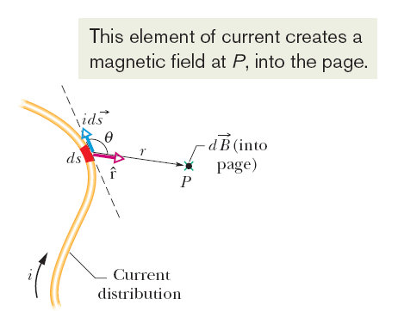

6. Magnetic Field due to a Current
(Biot-Savart Law)
The magnitude of the field dB produced at point P at distance r by a current length element i ds turns out to be
where θ is the angle between the directions of and , a unit vector that points from ds toward P. Symbol μ₀ is a constant, called the permeability constant, whose value is :
µ₀= 4πx10⁻⁷ T.m/A ≈ 1,26x10⁻⁶ T.m/A
Fig.6. Magnetic Field due to a Current

Slide 17

Magnetic Field due to a Current (cont.)

Slide 18

Magnetic Field due to a Current (cont.)
Magnetic Field due to a Long Straight Wire:
The magnetic field vector
At any point is tangent to a
circle
The magnitude of the magnetic field at a perpendicular distance R from a long (infinite) straight wire carrying a current i is given by
Wire with current
Into the page
Fig.7. The magnetic field lines produced by a current in a long straight wire form concentric circles around the wire. Here the current is into the page, as Indicated by the X.

Slide 19
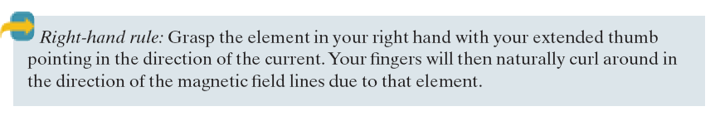
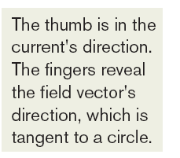
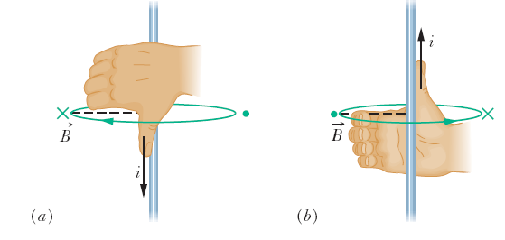
Magnetic Field due to a Current (cont.)

Slide 20





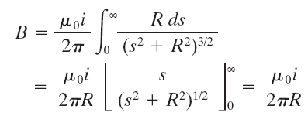

Magnetic Field due to a Current (cont.)
This element of current creates a magnetic field at P, into the page
ds
θ
S
i
Fig. 9. Calculating the magnetic
Field produced by a current i in a
long straight wire. The field dB at P associated with the current –length element ids is directed into the page, as shown.

Slide 21





8. Force Between Two Parallel Wires
The field due to a at the position of b creates a force on b
a
d
i_{a}
b
i_{b}
L
Fig.10. Two parallel wires carrying currents in the same direction attract each other. Is the magnetic field at wire b produced by the current in wire a is the resulting force acting on wire b because it carries current in

Slide 22
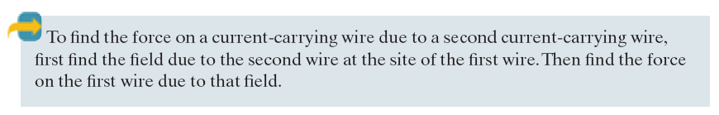
Force Between Two Parallel Wires (cont.)
a
d
i_{a}
b
i_{b}
L

Slide 23


9. Ampere’s Law
To find the magnetic field, if the distribution of currents has some symmetry, we able to apply Ampere’s law.
The loop on the integral sign means that the scalar (dot) product is to be integrated around a closed loop, called an Amperian loop.
The current i_{enc} is the net current encircled by that closed loop

Slide 24
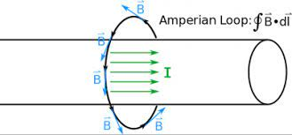
Ampere’s Law (cont.)

Slide 25

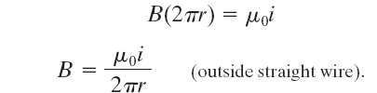

Magnetic Field Outside a Long Straight Wire Carrying Current:
Amperian
loop
All of the current is
Encircle and thus all
is used in Ampere’s law.
Wire
surface
(θ=0⁰)
Fig.11. Using Ampere’s law to find the magnetic field that a current i produces outside a long straight wire of circular cross section. The Amperian loop is a concentric circle that lies outside the wire.

Slide 26




Ampere’s Law (cont.)
Only the current uncircled by the loop is used in Ampere’s law.
Wire surface
Amperian loop
Fig. 12. Using Ampere’s law to find the magnetic field that a current i produces inside a long straight wire of circular cross section. The current is uniformly distributed over the cross section of the wire and emerges from the page. An Amperian loop is drawn inside the wire.

Slide 27
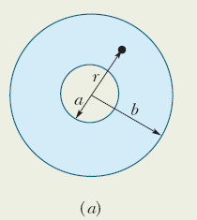
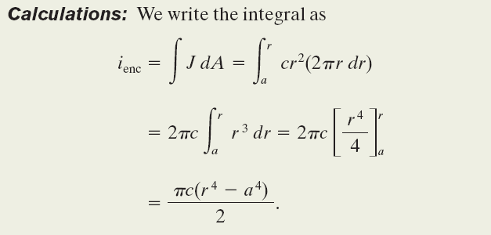
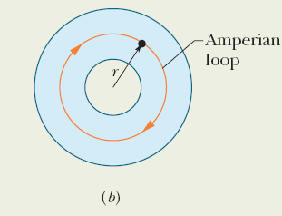
Ampere’s Law (cont.)
Example, Ampere’s Law to find the magnetic field inside a long cylinder of current.
Figure13. Shows the cross section of a long conducting cylinder with inner radius a= 2,0 cm and outer radius b=4,0 cm. The cylinder carries a current out of page and magnitude of the current density in the cross section is given by J=cr², with c=3,0x10⁶ A/m⁴ and r in meters.

Slide 28
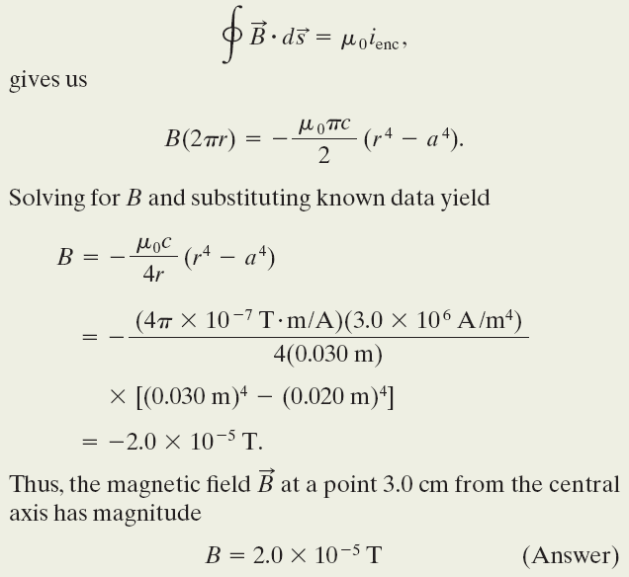
Ampere’s Law (cont.)
Example, Ampere’s Law to find the magnetic field inside a long cylinder of current.
Figure13. Shows the cross section of a long conducting cylinder with inner radius a= 2,0 cm and outer radius b=4,0 cm. The cylinder carries a current out of page and magnitude of the current density in the cross section is given by J=cr², with c=3,0x10⁶ A/m⁴ and r in meters.

